Slide 1
PROJECT TITLE : Analytics of Scanned Prescriptions and Notes.
PIP104 University Project-II
Review-1
Batch Number: CSE-G25
Roll Number | Student Name
20201CSE0095 | G RISHIKESH
20201CSE0120 | MANGAMURI RAMU
20201CSE0158 | TEJASWINI C
20201CSE0166 | SAMSON S
Under the Supervision of,
Mr. Ramesh T
Assistant Professor
School of Computer Science & Engineering
Presidency University

Slide 2
Abstract
A medical prescription given by a doctor contains the names of the medications, dosages and instructions for use for a specific patient.
It is generally handwritten by the busy doctor in an illegible way; which may be difficult for patients or sometimes even pharmacists to interpret the name of one or more medication(s) written in it.
Sometimes, the doctor may even write abbreviations for the directions of use of the medicines; which are commonly known to pharmacists nearby that hospital. The major criteria lies in identifying the name of the medicine correctly.
Hence, we are in need of a solution which uses CNN, NLP, OCR and machine learning techniques for handwriting recognition to identify the names of the medications in the prescription; given an image of the prescription.

Slide 3
Literature Survey
Paper | Title | Year of publication | Proposed System
1 | Medical Prescription Recognition using Machine Learning | 2021 | The proposed system uses a combination of image processing techniques and machine learning algorithms to recognize handwritten medicine names from images of prescription notes.
2 | Medical Prescription recognition using machine learning: A survey | 2023 | The system adopts the transformer model, a state-of-the-art approach for text recognition, to accurately identify the medication listed on the prescription
3 | Medical Prescription Identification Solution | 2021 | This system uses a neural network approach for the character recognition process and a knowledge based matching to accurately output the result.
4 | An online cursive handwritten medical words recognition system | 2022 | A bidirectional long short- term memory (LSTM) network is used to recognize the handwriting. it uses data augmentation techniques to improve the recognition efficiency.

Slide 4
Objectives
To assess the feasibility of using scanned prescription and notes for analysis.
To investigate the potential of Optical Character Recognition (OCR) and Natural Language Processing (NLP) techniques in analyzing the patterns (characters) of the cursive handwriting and recognize the medication.
designing a medication name recognizer for pharmacists or patients to enhance prescription-reading accuracy and patient safety.

Slide 5
Proposed Method
To develop a mobile application which can take a cropped part of a medical prescription, containing only the doctor’s handwritten part as input; and recognize the names of the medications and it’s dosage accurately and return their names in a digital, readable form.
In order to achieve this, we implement a machine learning model using python and train it on various data sources, including EMINIST and Kaggle (A_Z_dataset_medicines_dataset_of_India.csv) datasets.
In order to ensure seamless integration, we utilize TensorFlow, Keras and OpenCV for the backend of the application and cloud firebase for storing and managing the data. Once a user logs into the app, they have the option to scan or upload an image of their prescription. The app will then process the image using the machine learning model and display the recognized medication and its associated information for the user to easily read and understand.

Slide 6
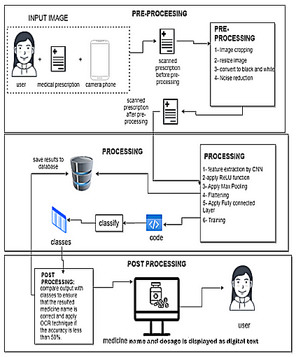
Architecture diagram
Overall process diagram

Slide 7
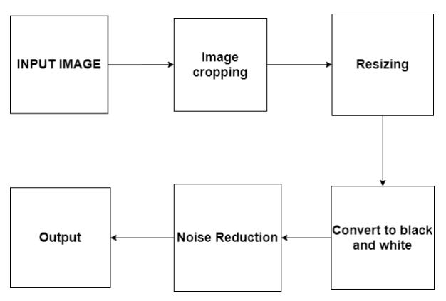
Modules
Block diagram of pre-processing phase
The pre-possessing module accesses the camera module of the mobile device; which can click an image of a prescription. After that; the user has to crop the image such that only the doctor’s handwritten part is visible clearly. Later, it’s passed on to the further phases of the pre-processing module; and the final output of this module; which is a clear version of the middle part of the prescription, containing only the doctor’s handwritten part; is passed on to next module.

Slide 8
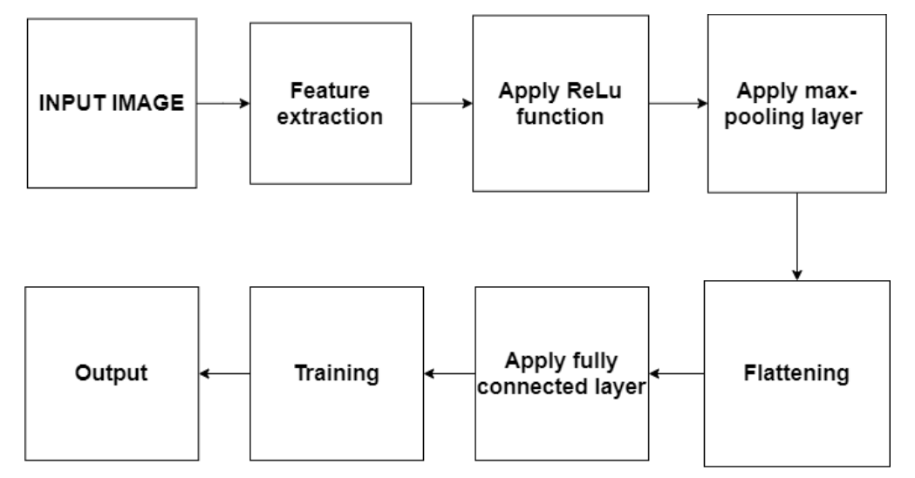
Modules
Block diagram of processing phase
The clearer version of the doctor’s handwritten part is inputted to this module. The processing module majorly contains the handwriting recognition pipeline; majorly performing feature extraction(identifying parts in the prescription where a medication name is present), and after further processing for recognition; returns a vector of images containing only the characters present in the name.

Slide 9
Modules
Post-processing module :
The character groups obtained are combined to form words. After we get the predicted word (name of the medicine), the result is passed through a matching algorithm. This is done to remove any errors in the prediction. (for example: sometimes the medicine 'crocin' may get predicted as 'crocim') After these errors are removed, we get the full name of the medicine.
Optical Character Recognition (OCR) will be applied on the resulted medicines to process character by character, comparing the OCR result with a data set which contains all the medicine names to recognize which medicine in the dataset nearest to the result.

Slide 10
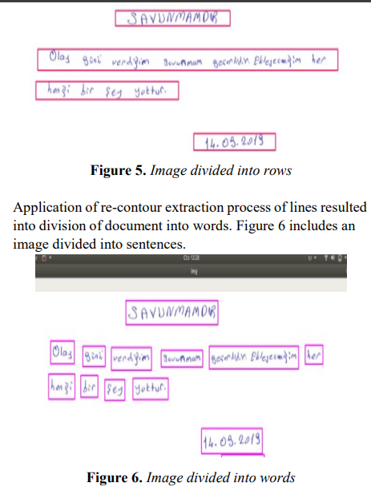
OCR in action
Here, contours (segments) are formed around recognized handwritten text in 2 stages :
For lines
For words

Slide 11
Technologies to be used
Name | Description
Flutter | Flutter is an open-source UI software development kit created by Google. It is used to develop applications for Android, iOS, Linux, Mac, Windows, Google Fuchsia, and the web from a single codebase.
Cloud Firestore | Cloud Firestore is a flexible, scalable database for mobile, web, and server development by Firebase and Google Cloud.
Firebase Storage | Cloud Storage for Firebase is a powerful, simple, and cost-effective object storage service built for Google scale.
TensorFlow | TensorFlow is an open-source software library for machine learning. TensorFlow Lite is a set of tools that enables on-device machine learning by helping developers run their models on mobile, embedded, and IoT devices. We are going to use TensorFlow Lite for Android during the project.
Keras | Keras is an open-source software library that provides a Python interface for artificial neural networks.
Open CV | OpenCV is a library of programming functions mainly aimed at real-time computer vision.
Android Studio | Android Studio is an Integrated Development Environment (IDE) for developing apps to be run on Google’s Android operating system.

Slide 12
Timeline of the project
The project is expected to take 4 months (tentatively) for completion.
Timeline | Events
Month 1 | Planning about methodology, hardware & software details, modules in the software
Month 2 | Framing the algorithm, writing the code, implementing the backend code (50%)
Month 3 | Finishing the backend code, UI development, checking the code for proper functionality, finishing the report work.
Month 4 | Testing the finished software.

Slide 13
References
Medical Prescription Recognition using Machine Learning; by Esraa Hassan, Habiba Tarek, Mai Hazem, Shaza Bahnacy, Lobna Shaheen, Walaa H. Elashmwai
Medical Prescription Identification Solution, by W.R.A.D Wijewardena under the supervision of Prof. N.D. Kodikara
Medical prescription recognition using Machine Learning – A survey; by Neha Nayak, Prarthana T, Rohit Joshi, Vaibhavi S, Dr Swathi K
OCR Optical Character Recognition by Line Eikvil
Machine Printed Text and Handwriting Identification in Noisy Document Images; by Yefeng Zheng, Student Member, IEEE, Huiping Li and David Doermann, Members of IEEE.
An online cursive handwritten medical words recognition system for busy doctors in developing countries for ensuring efficient healthcare service delivery; by ShairaTabassum, Nuren Abedin, Md Mahmudur Rahman, Md Moshiur Rahman, Mostafa TaufqAhmed, Rafqul Islam & Ashir Ahmed
Identification of Handwritten Text in Machine Printed Document Images; by Sandipan Banerjee
Looking Beyond Text: Extracting Figures, Tables and Captions from Computer Science Papers Christopher Clark and Santosh Divvala
Automatic Indexing of Scanned Documents - a Layout-based Approach; by Daniel Essera, Daniel Schustera, Klemens Muthmanna, Michael Bergerb, Alexander Schilla aTU Dresden, Computer Networks Group, 01062 Dresden, Germany bDocuWare AG, Therese-Giehse-Platz 2, 82110 Germering, Germany

Slide 14
Thank You

